Slide 1
Slide 7
Function
Dasar-Dasar Pemrograman 1
Semester Ganjil 2016/2017

Slide 2
Functions
A function is a device that groups a set of statements so they can be run more than once in a program
Functions can compute a result value and let us specify parameters that serve as function inputs and may differ each time the code is run
Coding an operation as a function makes it a generally useful tool, which we can use in a variety of context
Dasar-Dasar Pemrograman Ganjil 2016-2017

Slide 3
Functions (1)
Functions are the most basic program structure for maximizing code reuse
Functions let us split complex systems into manageable parts. By implementing each part as a function, we make it both reusable and easier to code
Dasar-Dasar Pemrograman Ganjil 2016-2017

Slide 4
Functions and Parameters
A function definition looks like this:
def <function-name>(<formal-parameters>):
<body>
The name of the function must be an identifier
Formal-parameters is a possibly empty list of variable names
The def statement creates a function object and assigns it to a name
Dasar-Dasar Pemrograman Ganjil 2016-2017

Slide 5
Functions and Parameters
The scope of a variable refers to the places in a program where the variable can be referenced
Each function is its own little subprogram. The variables used inside of a function are local to that function, even if they happen to have the same name as variables that appear inside of another function
Formal parameters, like all variables used in the function, are only accessible in the body of the function. Variables with identical names elsewhere in the program are distinct from the formal parameters and variables inside of the function body
Dasar-Dasar Pemrograman Ganjil 2016-2017

Slide 6
Functions and Parameters (1)
A function is called by using its name followed by a list of actual parameters or arguments
<function-name>(<actual-parameters>)
When Python comes to a function call, it initiates a four-step process
Dasar-Dasar Pemrograman Ganjil 2016-2017

Slide 7
Four-Step Process of a Function Call
The calling program suspends execution at the point of the call
The formal parameters of the function get assigned the values supplied by the actual parameters in the call
The body of the function is executed
Control returns to the point just after where function was called
Dasar-Dasar Pemrograman Ganjil 2016-2017

Slide 8
Four-Step Process of a Function Call (1)
a=5
def fungsi1(a):
b = a*4
…..
…..
….
fungsi1(5)
….
Dasar-Dasar Pemrograman Ganjil 2016-2017

Slide 9
Function Call
For multiple parameters, the formal and actual parameters are usually matched up based on position, i.e. the first actual parameter is assigned to the first formal parameter, the second actual parameter is assigned to the second formal parameter etc.
a=5
b=6
def fungsi1(a,b):
b = a*4
…..
…..
….
fungsi1(5,6)
….
Dasar-Dasar Pemrograman Ganjil 2016-2017

Slide 10
Functions that Return Values
This function returns the square of a number:
def square(x):
return x*x
When Python encounters return, it exists the function and returns control to the point where the function was called
In addition, the value provided in the return statement are sent back to the caller as an expression result
Dasar-Dasar Pemrograman Ganjil 2016-2017

Slide 11
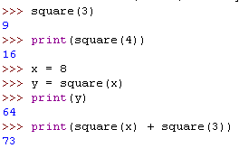
Example
Dasar-Dasar Pemrograman Ganjil 2016-2017

Slide 12
Function that Return Values (1)
All Python functions return a value, whether they contain a return statement or not. Functions without a return hand back a special object, denoted None
Dasar-Dasar Pemrograman Ganjil 2016-2017

Slide 13
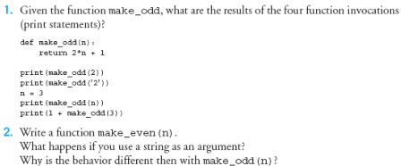
Latihan
Dasar-Dasar Pemrograman Ganjil 2016-2017

Slide 14
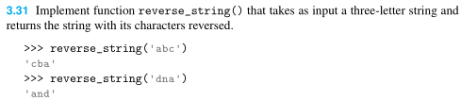

Latihan (1)
Dasar-Dasar Pemrograman Ganjil 2016-2017

Slide 15
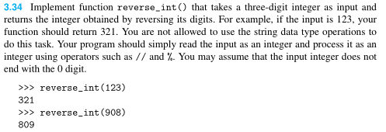
Latihan (2)
Dasar-Dasar Pemrograman Ganjil 2016-2017

Slide 16
Functions that Modify Parameters
Return values are the main way to send information from a function back to the caller
Sometimes, we can communicate back to the caller by making changes to the function parameters
Understanding when and how this is possible requires the mastery of some subtle details about how assignment works and the relationship between actual and the formal parameters
Dasar-Dasar Pemrograman Ganjil 2016-2017

Slide 17

Functions that Modify Parameters (1)
Suppose you are writing a program that manages bank accounts. One function we would need to do is to accumulate interest on the account. Let’s look at a first-cut at the function
Dasar-Dasar Pemrograman Ganjil 2016-2017

Slide 18
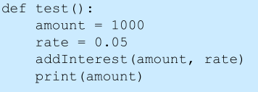
Functions that Modify Parameters (2)
The intent is to set the balance of the account to a new value that includes the interest amount
Let’s write a main program to test this:
Dasar-Dasar Pemrograman Ganjil 2016-2017

Slide 19

Functions that Modify Parameters? (3)
We hope that the 5% will be added to the amount, returning 1050
What went wrong? Nothing! That’s how Python works
Python is said to pass all parameters by value (behave similar to assignment)
Dasar-Dasar Pemrograman Ganjil 2016-2017

Slide 20
Functions that Modify Parameters? (4)
The solution would be to change the addInterest function so that it returns the newBalance
And assign the value returned by addInterest to the variable amount
Dasar-Dasar Pemrograman Ganjil 2016-2017

Slide 21
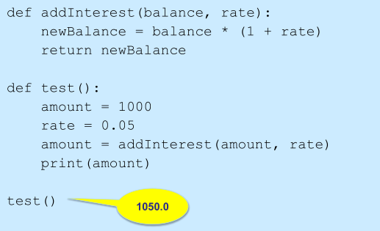
Functions that Modify Parameters? (5)
Dasar-Dasar Pemrograman Ganjil 2016-2017

Slide 22
Functions that Modify Parameters? (6)
There is another solution: use a mutable object such as list
Instead of looking at a single account, say we are writing a program for a bank that deals with many accounts. We could store the account balance in a list, then add the accrued interest to each of the balances in the list
We could update the first balance in the list with code like:
  balances[0] = balances[0] * (1 + rate)
Dasar-Dasar Pemrograman Ganjil 2016-2017

Slide 23
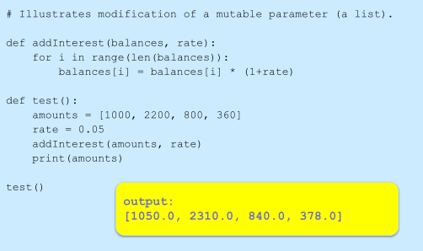
Functions that Modify Parameters? (6)
Dasar-Dasar Pemrograman Ganjil 2016-2017

Slide 24
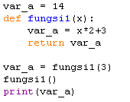
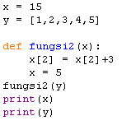
Latihan
Tampilkan output dari kode berikut:
1. 2.
Dasar-Dasar Pemrograman Ganjil 2016-2017

Slide 25
References
William Punch & Richard Enbody. The Practice of Computing using Python, 2nd Edition. Addison-Wesley, 2013
Y. Daniel Liang. Introduction to Programming Using Python. Prentice Hall, 2013.
John Zelle. Python Programming: An Introduction to Computer Science, 2nd Edition. Franklin, Beedle & Associates Inc., 2010.
Mark Lutz. Learning Python, 5th Edition. O’Reilly Media. Copyright 2013 Mark Lutz, 978-1-44-93-5573-9
L. Y. Stefanus. Slide Pelatihan Python. 2015.
Dasar-Dasar Pemrograman Ganjil 2016-2017

